Slide 1
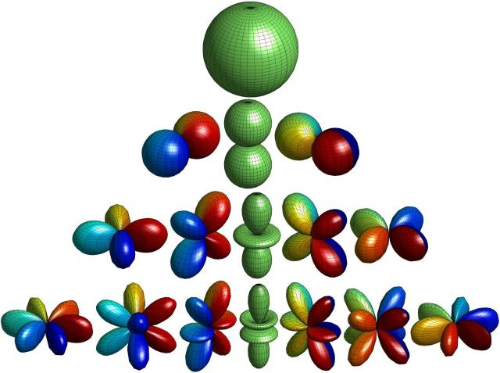
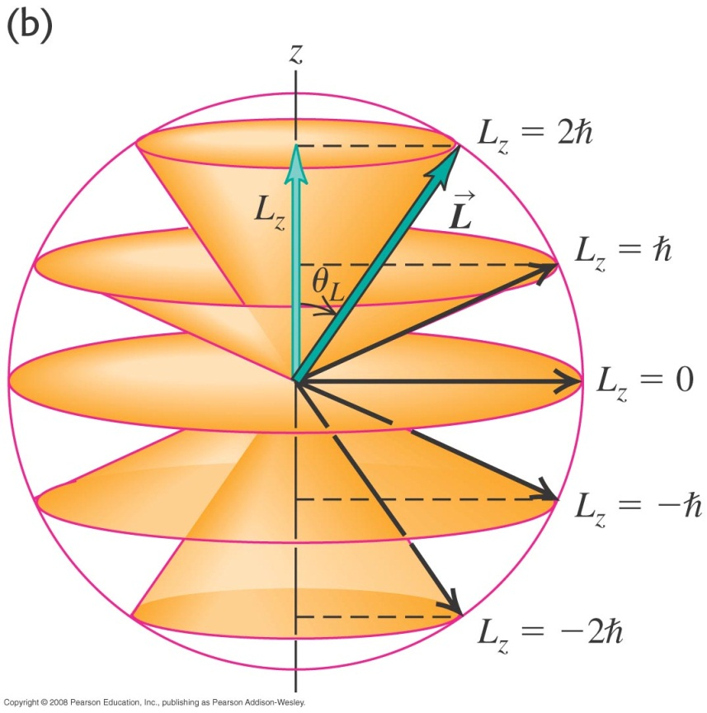
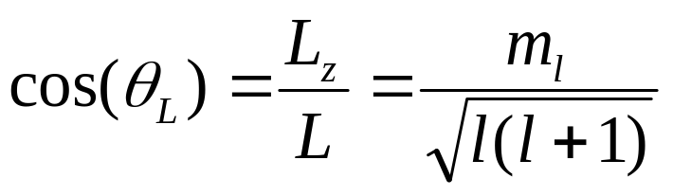
Orientation in space
Note that uncertainty principle also requires that if L_{z} = 2ħ, L cannot have the magnitude of 2ħ. Otherwise, L_{x} and L_{y} have both to be 0 and L would be known precisely (not possible in QM).
Thus we can visualize L as to be on cones that have “heights” of values m_{l}ħ = L_{z}.
The angle that L made with the z-axis is given by:

